Slide 1

CG1112
Engineering Principles and Practices II
Sneak Preview
colintan@nus.edu.sg

Slide 2
Introduction
So far we have used the Atmega328P (AVR) largely in “stand-alone” mode:
We’ve used GPIO to read/write binary devices like switches, and LEDs in simple fully on/fully off mode.
We’ve used PWM to write to analog devices, like controlling the brightness of an LED.
We’ve used timers to coordinate activities within the AVR chip.
In the next couple of studios we will look at coordinating between the AVR and smarter devices:
Other AVRs or MCUs.
Smart devices like GPS modules, LIDARs, compasses etc.
The topics we will be covering in Weeks 7, 8 and 9:
Week 7 Studio 1 – USART (aka Serial) communications
Week 7 Studio 2 – Designing communication protocols.
Week 8 Studio 2 – Controlling Vincent remotely.
Week 9 Studio 2 – Two-wire Interface (aka I2C)

Slide 3
U(S)ART Communications
The AVR’s serial communications channel is unique:
It operates in asynchronous mode, like many other serial channels.
This means that data is transmitted independently of any clocking signal. The receiver derives a clocking signal from the received data.
BUT it can also operate in synchronous mode.
Data transmit and received are coordinated by a separate clock.
For this reason the port is called an “Universal Synchronous/Asynchronous Receiver Transmitter” or USART.
Most devices including the Raspberry Pi only have UART ports – Universal Asynchronous Receiver Transmitter.
For EPP2 we will ignore synchronous operations, and use the USART port as a UART port.
However we will continue to refer to the port as an USART port.

Slide 4
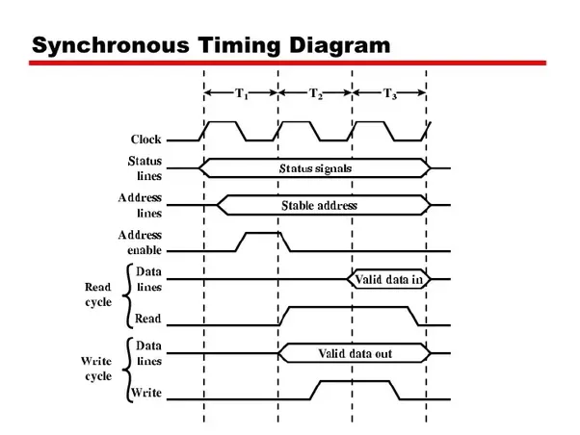
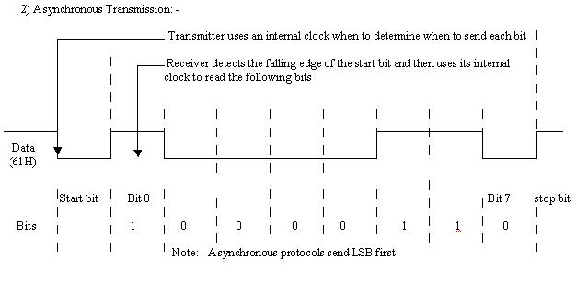
Synchronous vs. Asynchronous Data Transmission

Slide 5
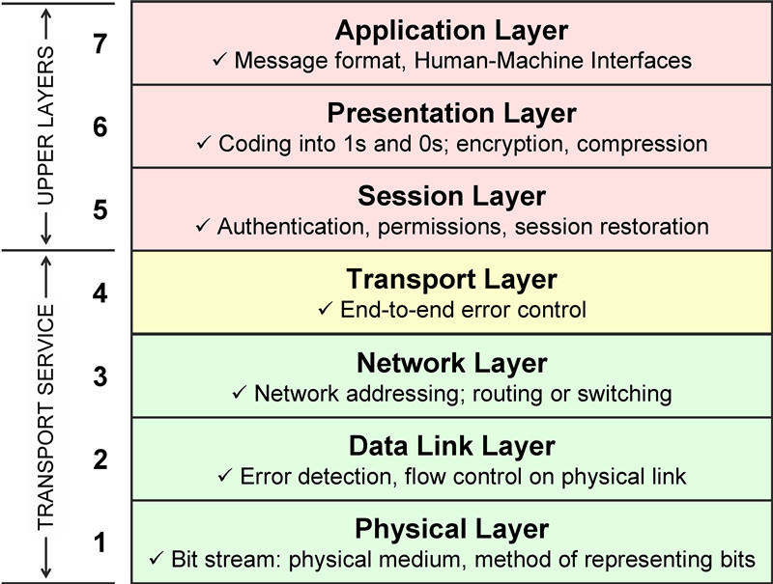
The ISO OSI Model
The International Standards Organization proposed the Open Systems Interconnect (OSI) standard a really, really long time ago.
It specifies 7 levels as shown on the right.
For now we are concerned with 3 layers:
The physical layer (layer 1) which specifies wiring and voltage levels.
The data link layer (layer 2) which specifies framing and error correction.
The application layer (layer 7) which specifies how we talk to devices. We will defer layer 7 to Week 7 Studio 2.
There will be a later studio relating to layers 3-6.
Mostly to do with networks of machines.

Slide 6
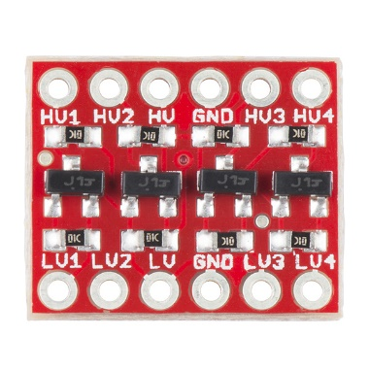
USART Transmission Specification
Physical layer:
Total of three wires:
Receive (RX): Incoming data bits come here.
Transmit (TX): Outgoing data bits go out from here.
Ground (GND): Return path for RX and TX. Both receiver and transmitter must share a common ground.
Voltage level:
5v for standard devices (e.g. Arduino UNO)
3.3v for low-power devices (e.g. Raspberry Pi)
When connecting a 5v and 3.3v device together, you SHOULD use a level converter (shown on the right).
For EPP2 we will cheat:
We will connect the UNO to the USB of the Raspberry Pi.
USB works at 5v. Conversion to 3.3v is handled by the Pi itself.

Slide 7
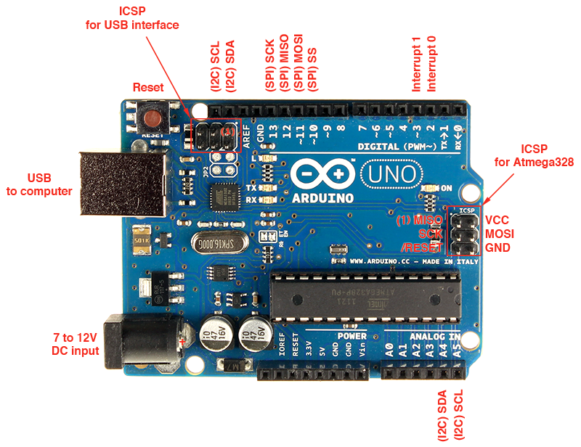
Communication Ports on the Arduino UNO
USART Port

Slide 8
Connecting Two Arduino UNOs

Slide 9
USART Transmission Specification
Data Link Layer:
To set up a USART session between two computers (Arduino UNO or otherwise), BOTH sides must agree on:
Number of data bits – 5, 6, 7, 8 or 9. Standard is 8.
Type of parity bit: None (N), Even (E) or Odd (O).
Number of stop bits: 1 or 2.
Both sides must also agree on bit rate: 1200, 2400, 4800, 9600, 38400, 57600, 115200 bits per second. Other rates are available.
Note: “Bit rate” and “baud rate” aren’t exactly the same thing, but are often used interchangeably.
On parity:
This is an extra bit added for error checking.
Odd: The extra bit is set to 1 to make the total number of 1 bits odd.
Even: The extra bit is set to 1 to make the total number of 1 bits even.
The receiving side will count the number of 1 bits to ensure that it is odd or even as previously agreed.

Slide 10
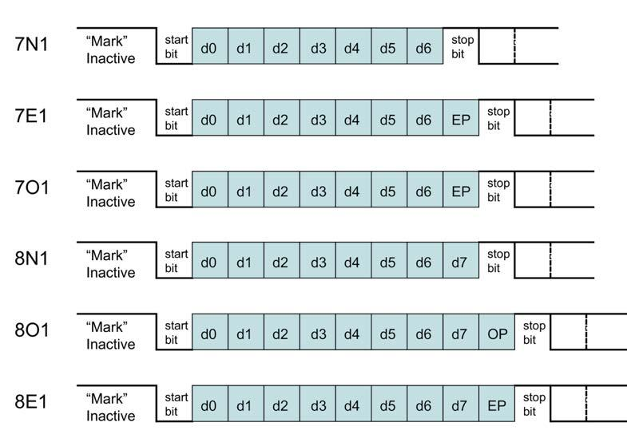
USART Frame Formats
A “frame” is a unit of data transmission.

Slide 11
Programming USART On the Atmega328P
We will now look at how to program the UART port on the Atmega328P:
Setting up the Connection.
Sending / Receiving Data in Polling Mode.
Sending / Receiving Data in Interrupt Mode.
There are two UART modes:
Asynchronous Normal Mode.
UART as described earlier.
Asynchronous Double Speed Mode.
UART as described earlier, but with data being transmitted at twice the specified rate.
Requires stable and accurate clocking circuits on the board.
We will not use this mode.

Slide 12
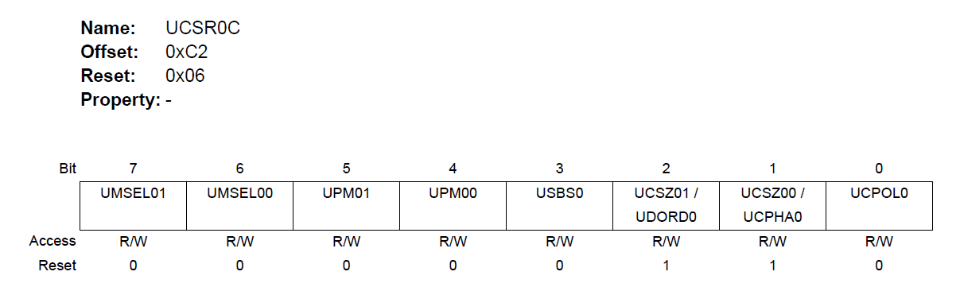
Setting Up the USART
We can set the mode (asynchronous or synchronous), byte size (5,6,7,8 or 9 bits), parity mode (None, Even or Odd) and number of stop bits (1 or 2) in the USART Control and Status Register C (UCSR0C):

Slide 13
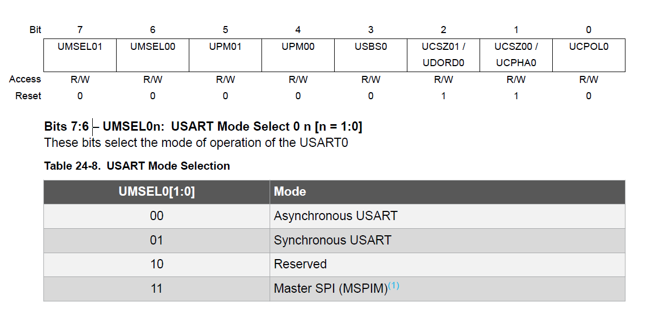
Setting Up the USART Setting the USART Mode
You can set bits 7 and 6 of UCSR0C to the values below to choose the mode you want.
We will use Asynchronous USART (i.e. UART) and chose 00:

Slide 14
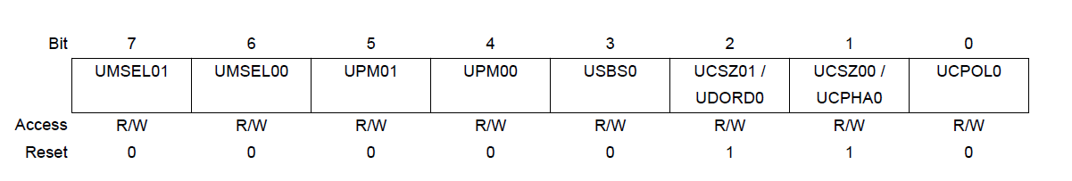
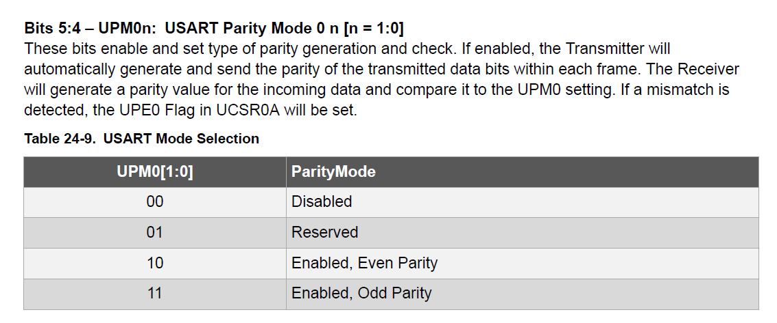
Setting Up the USART Setting the Parity Mode
Bits 5 and 4 are used to choose the parity mode:

Slide 15
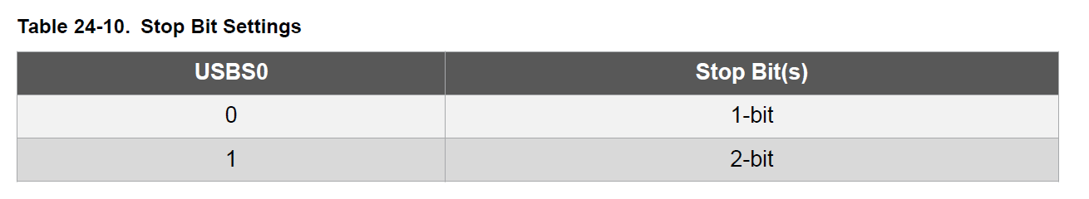
Setting Up the USART Setting the Number of Stop Bits
Bit 3 is used to set the number of stop bits:

Slide 16
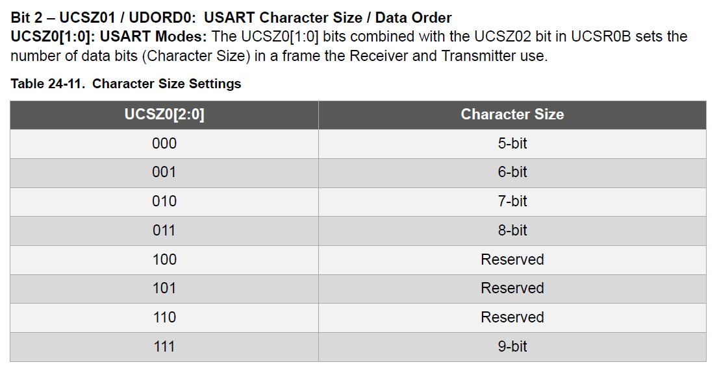
Setting Up the USART Setting the Data Size
Remember that we can choose data sizes of between 5 and 9 bits inclusive. We usually use 8 bits. We can do that by setting bits 2 and 1 of UCSR0C, and bit 2 of register UCSR0B (see later):

Slide 17
Setting Up the USART Setting the Clock Polarity
Bit 0 of UCSR0C is used to set the clock polarity in synchronous mode. For asynchronous mode this bit must be set to 0.

Slide 18
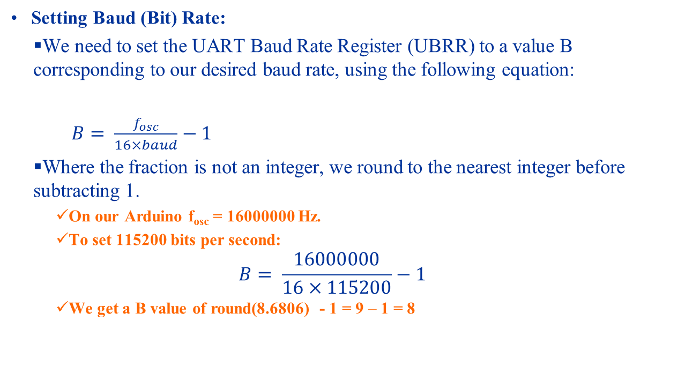
Setting Up the USART Setting Baud Rate
Setting Baud (Bit) Rate:
We need to set the UART Baud Rate Register (UBRR) to a value B corresponding to our desired baud rate, using the following equation:
$B= \frac{f_{osc}}{16×baud}−1$
Where the fraction is not an integer, we round to the nearest integer before subtracting 1.
On our Arduino f_{osc} = 16000000 Hz.
To set 115200 bits per second:
$$B= \frac{16000000}{16×115200}−1$$
We get a B value of round(8.6806) - 1 = 9 – 1 = 8

Slide 19
Setting Up the USART Setting Baud Rate
Setting Baud Rate:
The C code below shows how to set the baud rate you want in the UBRR registers (UBRR0L = lower byte, UBRR0H = higher byte).
void setBaud(unsigned long baudRate)
{
unsigned int b;
b = (unsigned int) round(F_CPU / (16.0 * baudRate))- 1;
UBRR0H = (unsigned char) (b >> 8);
UBRR0L = (unsigned char) b;
}

Slide 20
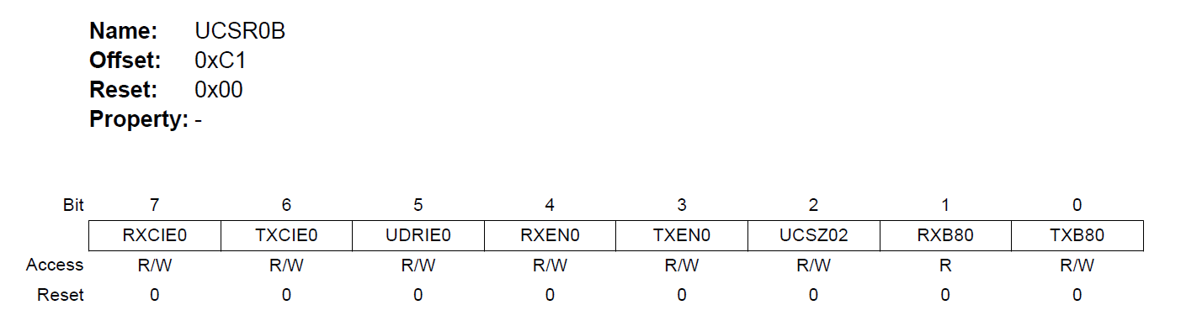
Setting Up the USART Enabling/Disabling Features
The UCSR0B register is used to enable/disable various interrupts, and to enable/disable the transmitter and receiver.
Note: Bit 2 (UCSZ02) together with bits 2 and 1 in UCSR0C are used to choose the data size (see “Setting Data Size” earlier).

Slide 21
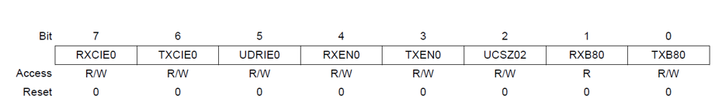
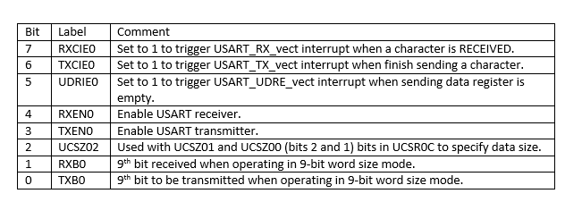
Setting Up the USART Enabling/Disabling Features

Slide 22
The USART Status Register (UCSR0A)
The UCSR0A register contains flags that tell us whether we can send data, or whether we can read data.
We will make use of while loops to poll some of these bits to wait for data or wait for the chance to send data.
This register also tells us about important error conditions like parity error, data overrun error or frame error.

Slide 23
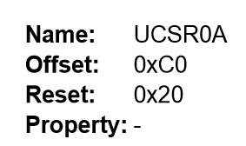
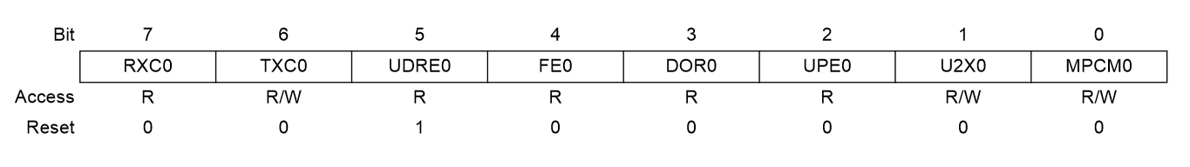
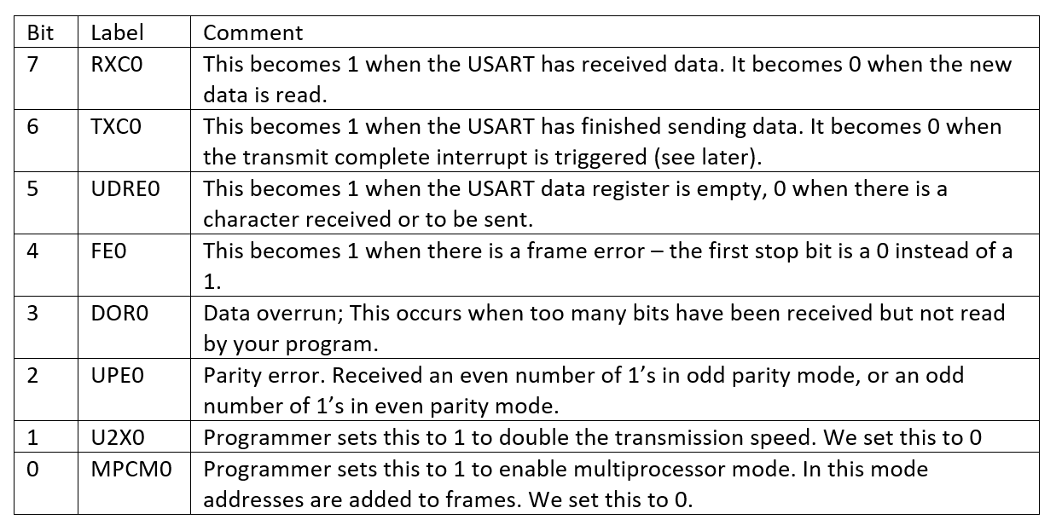
The USART Status Register (UCSR0A)

Slide 24

Setting Up the USART Complete Setup Code
Assume that we are using 9600 bps, 8N1 configuration (i.e. baud rate of 9600, 8 data bits, no parity bits, 1 stop bit). We first configure UCSR0C:
Running in UART mode, so we set bits 7 and 6 to 0b00 (see page 13)
We are using no parity, so we set bits 5 and 4 to 0b00 (see page 14)
We are using 1 stop bit, so we set bit 3 to 0b0 (see page 15)
We are using 8 data bits, so we set bit 2 of UCSR0B to 0, and bits 2 and 1 of UCSR0C to 0b11 (see page 16).
So we have:
In C:
UCSR0C = 0b00000110;

Slide 25
Setting Up the USART Complete Setup Code
Now we configure the baud rate register UBRR0L and UBRR0H:
We find our b-value:
b = round(16000000/(16 x 9600)) – 1
= 103
We load this value in UBRR0L and UBRR0H. Note that since 103 is less than 255, we can just load it into UBRR0L, and set UBRR0H to 0:
UBRR0L = 103;
UBRR0H = 0;

Slide 26

Setting Up the USART Complete Setup Code
Now finally we set UCSR0B. We will start first with a polling version of our UART code:
RXCIE0, TXCIE0 and UDRIE0 bits will be set to 0 to disable receive, transmit and data register empty interrupts.
Also:
UCSZ02 will be set to 0, because we need UCSZ02, UCSZ01 and UCSZ00 to be 0b011 for 8-bit data size.
RXB80 and TXB80 are “don’t care” bits, and we set them to 0.
However TXEN0 and RXEN0 must be set to 1 to enable the receiver and transmitter.
UCSR0B = 0b00011000;

Slide 27
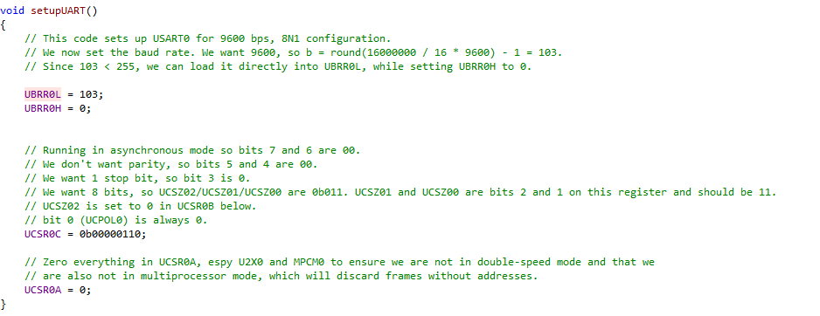
Setting Up the USART Complete Setup Code

Slide 28
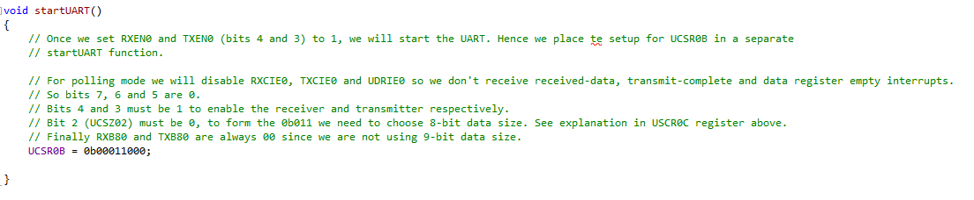
Setting Up the USART Complete Setup Code

Slide 29
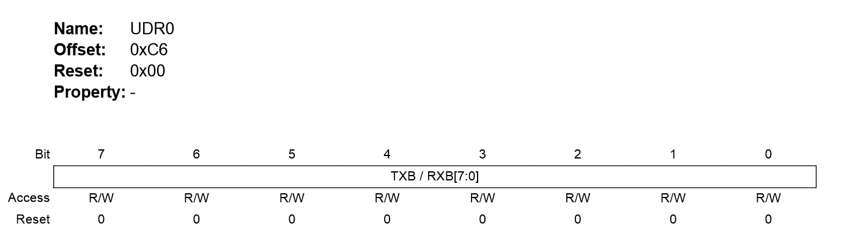
The USART Data Register
Data is written to and read from the USART Data Register UDR0.
You can read from this when the RXC0 bit (bit 7) in UCSR0A is set, or write to it when the TXC0 bit (bit 6) in UCSR0A is set.
Writing to UDR0 will cause data to be sent to the “other side”.
Read from UDR0 to receive data sent by the “other side”.

Slide 30
Sending Data In Polling Mode
Now that we have seen all the important registers, we are ready to send data:
We poll UDRE0 (circled) in UCSR0A until it is set. This means that UDR0 is empty.
We write the data to UDR0.
Note: You can also poll till TXC0 is set, but this is less efficient because TXC0 is not set until every bit of the previous byte has already been sent out.
In reality we only need to wait till UDR0 is empty. The USART can continue sending the previous byte as we write to UDR0.
We will use a mask of 0b00100000 to poll this bit (see next slide).

Slide 31
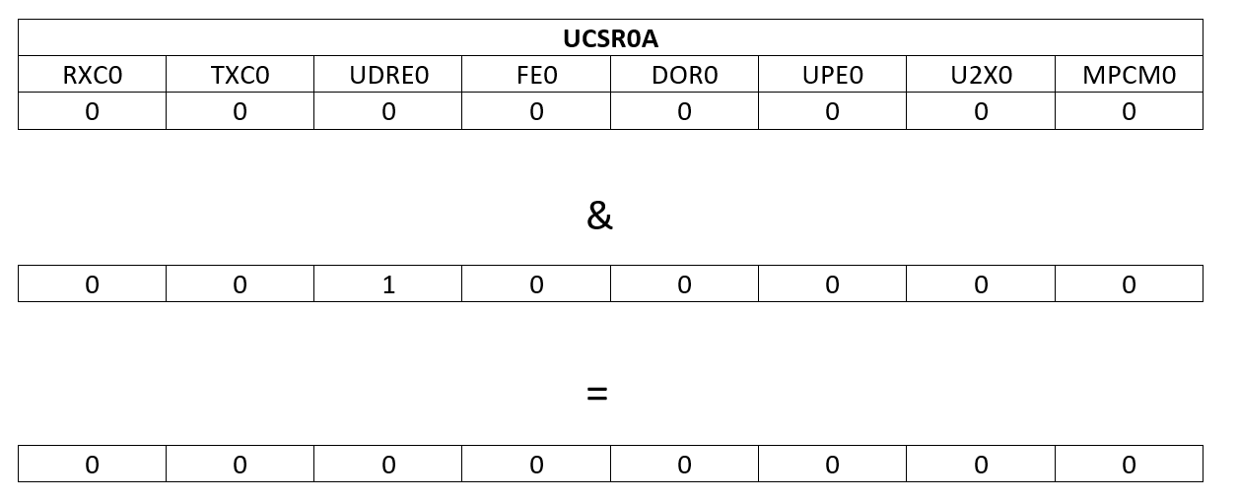
Sending Data In Polling Mode Polling UDRE0
If UDRE0 is 0, doing an AND against 0b00100000 will result in 0.

Slide 32
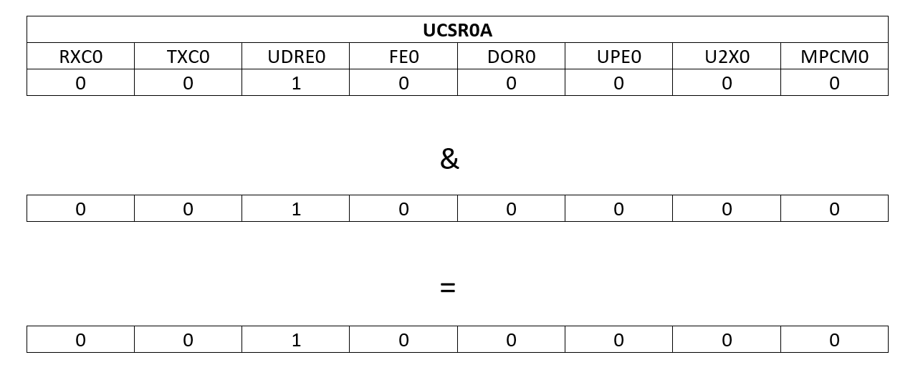
Sending Data In Polling Mode Polling UDRE0
If UDRE0 is 1, doing an AND against 0b00100000 will result in non-zero.

Slide 33
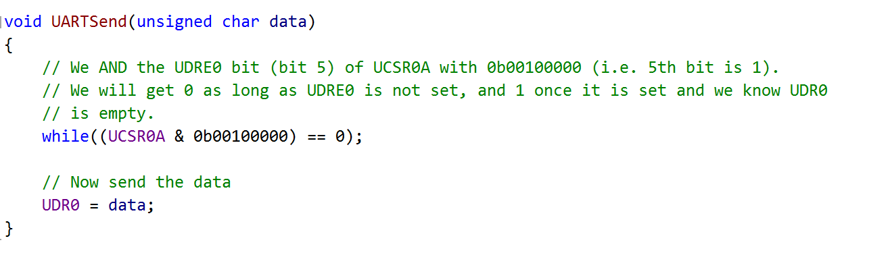
Sending Data In Polling Mode

Slide 34
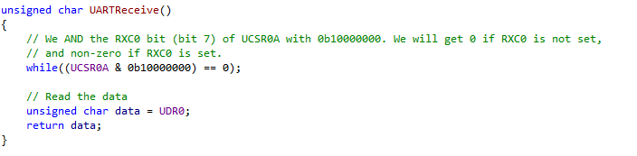
Receiving Data In Polling Mode
To receive data:
Keep polling the RXC0 bit (circled) in the UCSR0A register until it is 1.
Read the UDR0 register.

Slide 35
The Complete Serial By Polling Program
Open the uartpoll solution to see a complete “echo” program.
Read from serial port,
Echo back read character.
The main() is shown on the next slide. The setupUART, startUART, UARTSend and UARTReceive functions are as described above.
Notice the cli() and sei().
It is considered good practice to always disable interrupts when setting up hardware that can trigger interrupts (e.g. USART, timers), and re-enabling interrupts after setting up.

Slide 36
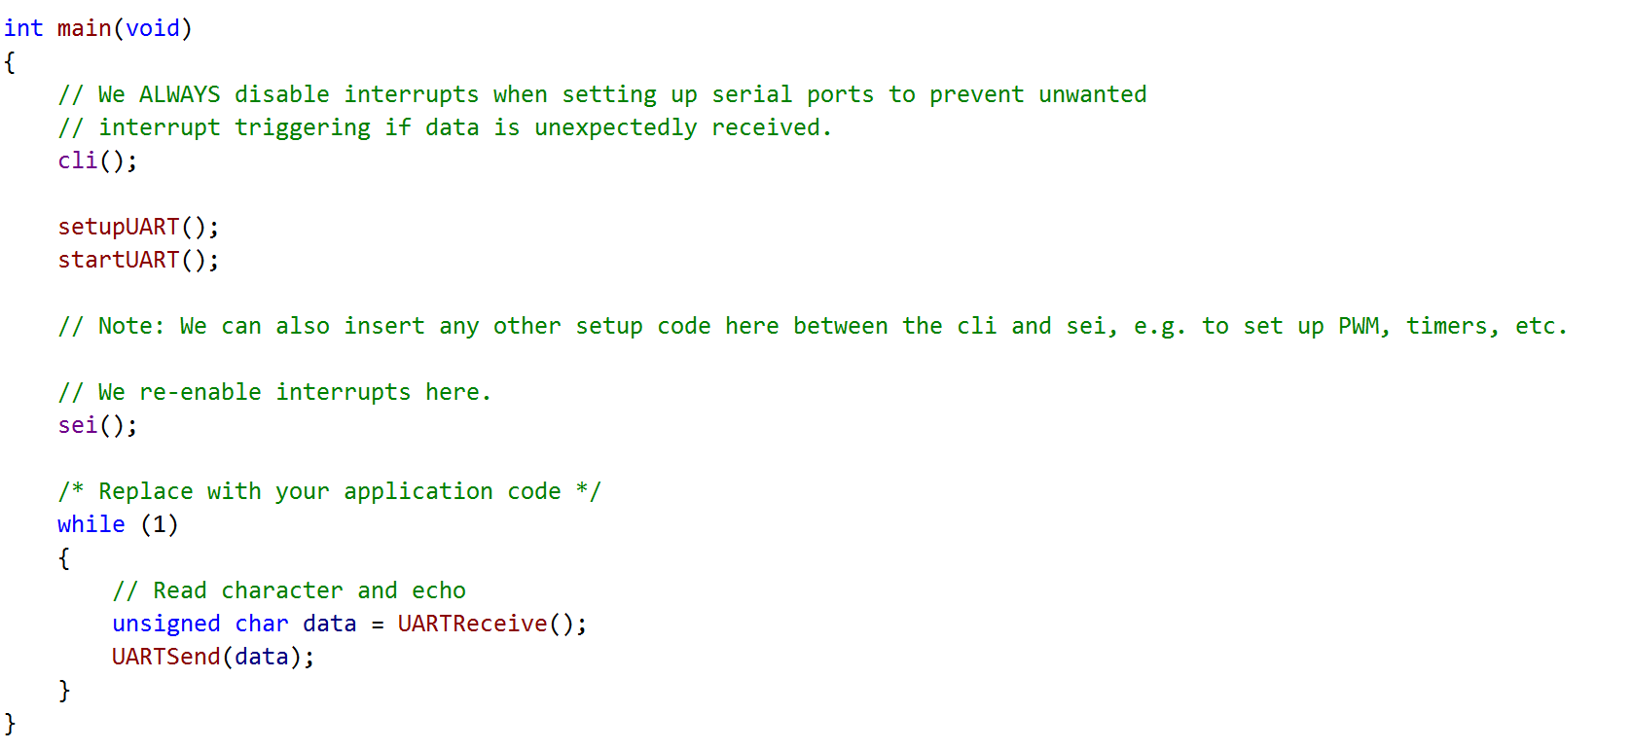
The Complete Serial By Polling Program

Slide 37
Setting Up USART for Interrupt Operations.
Usage of the USART in interrupt mode is almost exactly the same in polling mode EXCEPT:
We must set the RXCIE0 (Receive Complete Interrupt Enable) bit (bit 7) in UCSR0B to 1 and capture the USART_RX_vect interrupt.
We must set either:
UDRIE0 (USART Data Register Interrupt Enable) bit (bit 5) in UCSR0B and capture the USART_UDRE_vect interrupt, OR:
TXCIE0 (Transmit Complete Interrupt Enable) bit (bit 6) in UCSR0B and capture the USART_TX_vect interrupt.
For efficiency reasons we will make use of circular buffers for receiving and transmitting data:
Receiving:
ISR can continue to write to receive buffer as long as there is space.
Transmitting:
UDRE_vect or TX_vect ISR can continue to write to UDR0 as long as the buffer is not empty.

Slide 38
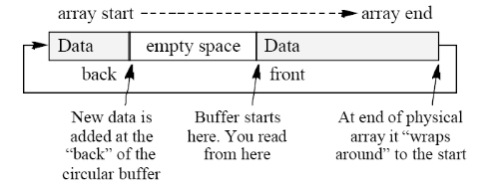
Circular Buffers
The diagram below shows a circular buffer:
Data is inserted using the “back” pointer.
Data is read using the “front” pointer.
Pointers are incremented using modulo:
back = (back + 1) % SIZE
front = (front + 1) % SIZE.
We will make use of a counter to decide when the buffer is empty or full.
See buffer.c and buffer.h in the uartint project.

Slide 39
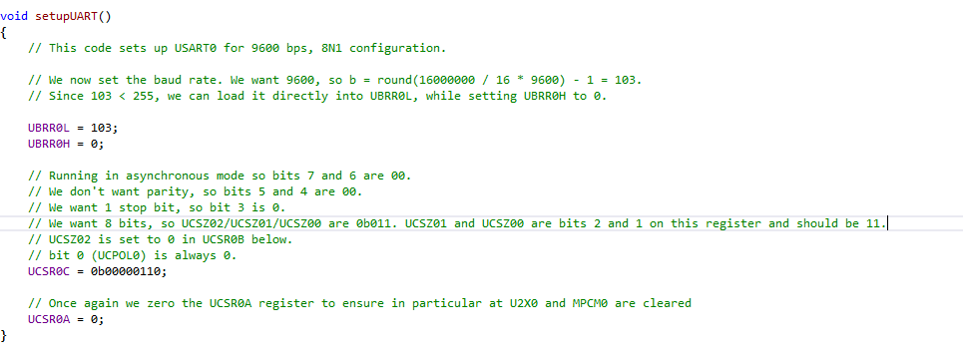
Setting Up the USART For Interrupt Mode
We are still using 9600 8N1 asynchronous mode, so the set up for UCSR0C is identical as in polling mode:

Slide 40
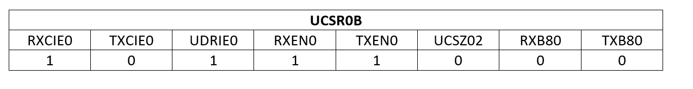
Setting Up the USART For Interrupt Mode
The configuration for UCSR0B is different: the RXCIE0 and UDRIE0 bits must be set to 1 to enable interrupts for Receive Complete and USART Data Register Empty conditions.
As before, RXEN0 and TXEN0 must be set to 1 to enable the receiver and transmitter:

Slide 41
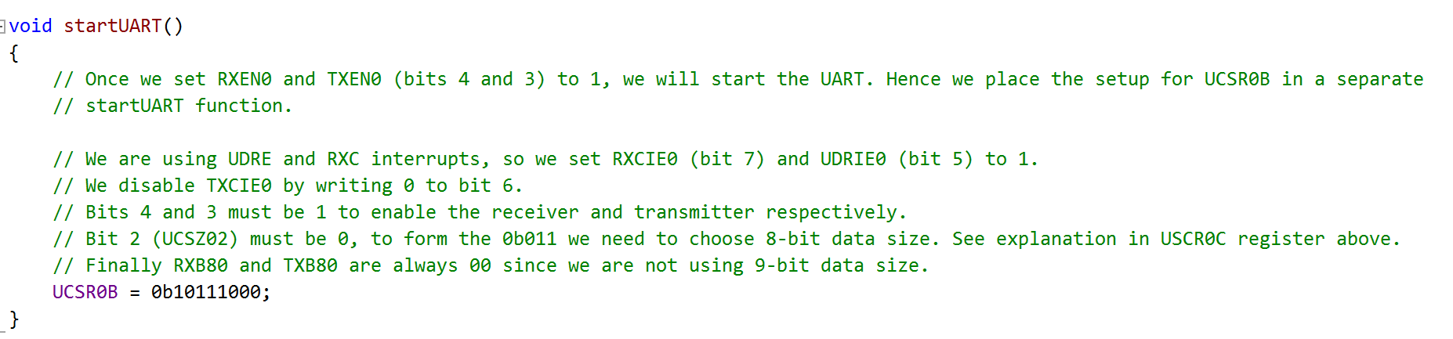
Setting Up the USART For Interrupt Mode

Slide 42
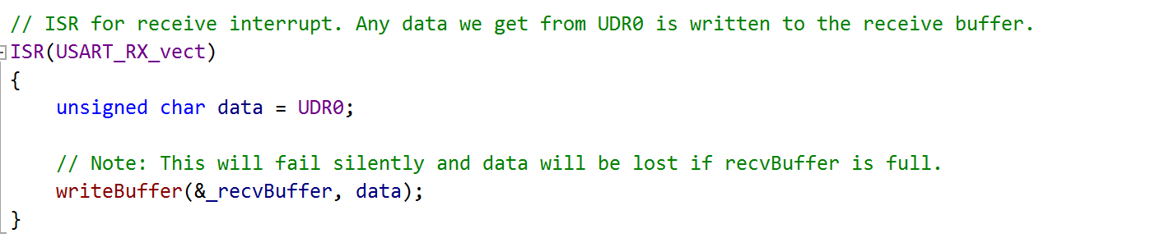
Setting Up Receive in Interrupt Mode
Whenever a character comes in, the USART_RX_vect interrupt is triggered:
Read the data from UDR0.
Insert it into the buffer.

Slide 43
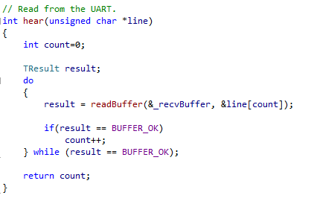
Setting Up Receive in Interrupt Mode

Slide 44
Setting Up Transmit in Interrupt Mode
For transmit we have a choice of using either the UDRE0 (USART Data Register Empty) or TXC0 (Transmit Complete) interrupts.
TXC0 waits for the shift register (remember these from Week 3?) to finish shifting the bits onto the transmission line before triggering the USART_TX_vect interrupt.
UDRE0 just waits for the data in UDR0 to be sent to the shift register before triggering the USART_UDRE_vect interrupt.
This is very slightly more efficient.
Principle:
Move first byte into UDR0 and set the UDRIE0 bit in UCSR0B to 1.
Once this byte is sent, the USART triggers the UDRE0 interrupt, caught by the USART_UDRE_vect vector.
Send the next byte if any, or set UDRIE0 in UCSR0B to 0 to stop further interrupts if there are no more bytes to send.

Slide 45
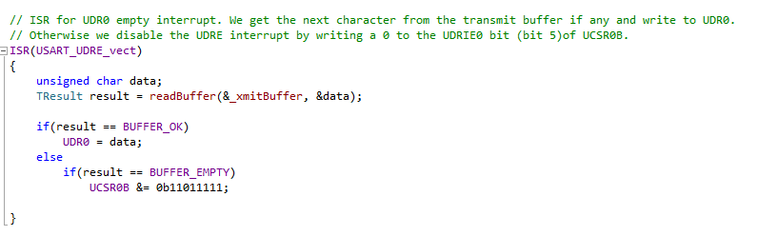
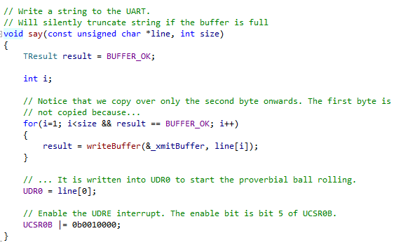
Setting Up Transmit in Interrupt Mode

Slide 46
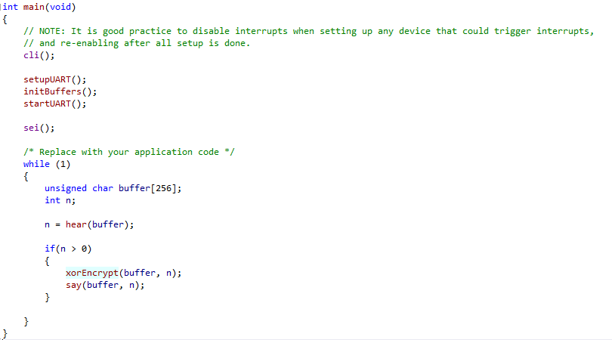
Using Our USART Program
Open the uartint Atmel Studio 7 Solution to see an example program that transforms the Arduino into your very own encryption engine!
Reads a string from the serial port.
Encrypts using XOR encryption.

